Slide 1

Skill Analyzer: Milestone 1 Presentation
by Srihitha K

Slide 2


Project Overview & Problem Statement
Skill Gap Analyzer: Milestone 1
The Challenge (Problem)
• Recruiters/Hiring Managers face difficulty manually reviewing and standardizing numerous resumes and job descriptions (JDs).
• Data Inconsistency: Documents are highly unstructured with varied section headers (e.g., "Core Competencies" vs. "Skills").
• Privacy Risk: Raw documents contain sensitive personal information (emails, phones, dates).
MilestoE-1 Goal
• Objective: To build an end-to-end data ingestion, cleaning, and rule-based skill extraction pipeline.
• Deliverable: A functional Streamlit application demonstrating core text processing and skill extraction.
Highlighted goals: Ingestion, Cleaning, Extraction, Demo App.

Slide 3

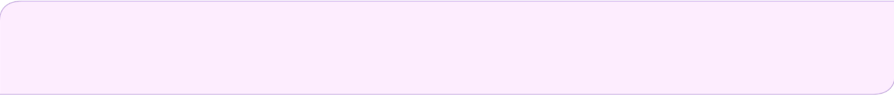
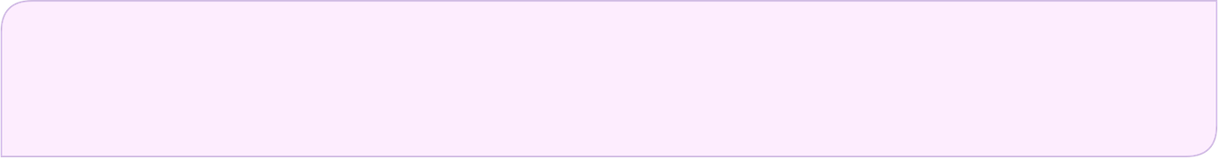
Solution Architecture & Technical Implementation
Solution Pipeline
• Workflow: Document Ingestion → Preprocessing → Skill Extraction → Analysis/Output.
Technical Stack
• Web App: Streamlit (for the UI/UX).
• File Handling: pdfplumber and python-docx for reading diverse formats (PDF/DOCX).
• NLP/Extraction: spaCy and PhraseMatcher (Rule-Based).
Preprocessing Details
• File Readers: Modules handle .pdf, .docx, and .txt files.
• Personal Info Removal: Regex-based replacement of emails, URLs, phones, and dates with placeholders (e.g., [EMAIL]).
• Section Normalization: Standardizing varied headers (like 'WORK HISTORY', 'CORE COMPETENCIES') into consistent tags (e.g., === EXPERIENCE ===).\
Skill Extraction Method
• Method: Rule-Based Matching using spaCy's PhraseMatcher.
• Process: Converts a pre-loaded skills list (skills_list.txt) into spaCy patterns.
• The matcher finds exact matches of these phrases in the cleaned text.
• Output: Returns a unique, sorted list of skills found & cleaned text

Slide 4

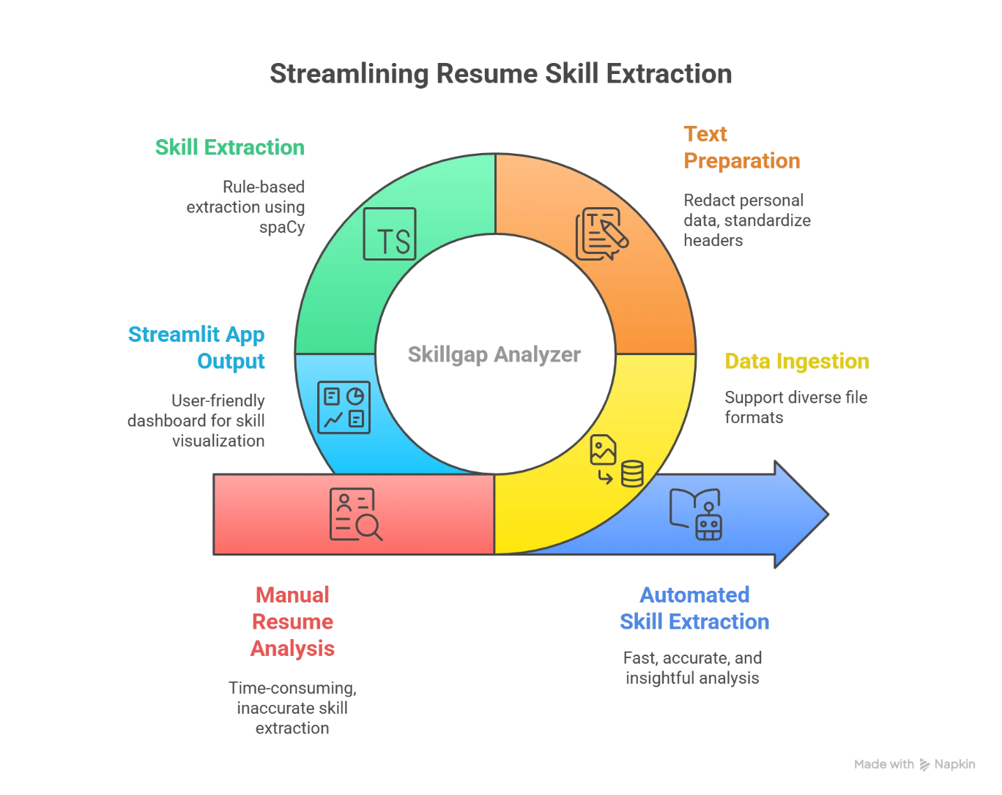

Slide 5

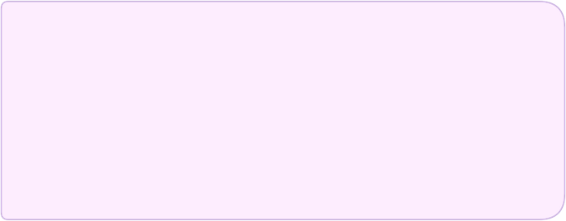
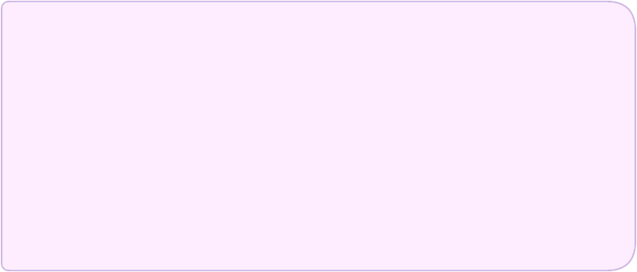
Output, Results & Demonstration
Demo: Streamlit App Interface
OUTPUT - Text Cleaning
• The Interface: A custom-styled "Magical Edition" Streamlit application for a friendly user experience.
• Before: Show a raw text snippet with noise and inconsistent headers.
• Functionality: Supports simultaneous upload of multiple resumes and a job description.
• After: Show the same snippet with personal info redacted ([PHONE], [DATE]) and headers standardized (=== SKILLS ===).
• Key Metric: Highlight the Text Optimization Percentage (e.g., 20.5% reduction).
OUTPUT - Skill Extraction
• The Results: Display the final set of unique skills extracted by the PhraseMatcher.
• Visualization: Showcase the Skill Tags and the Skills Distribution Bar Chart (from the Analytics tab).\

Slide 6
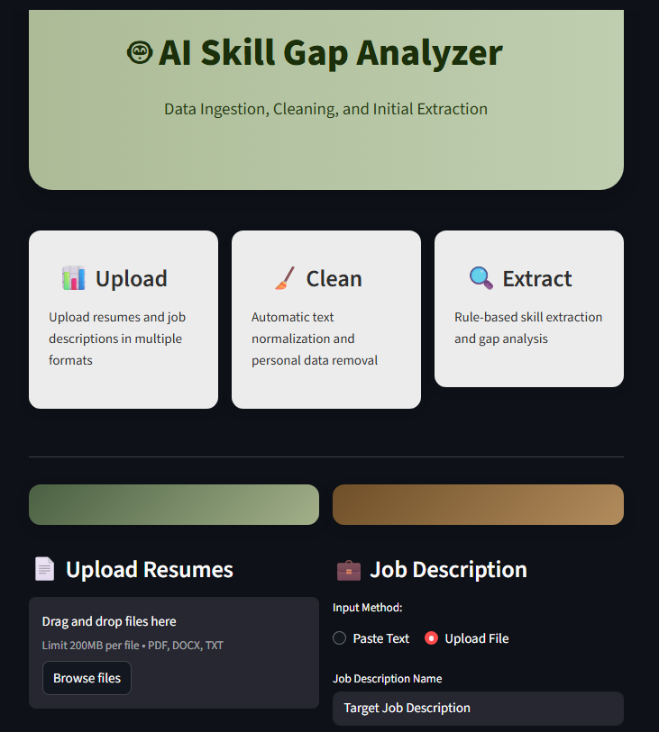
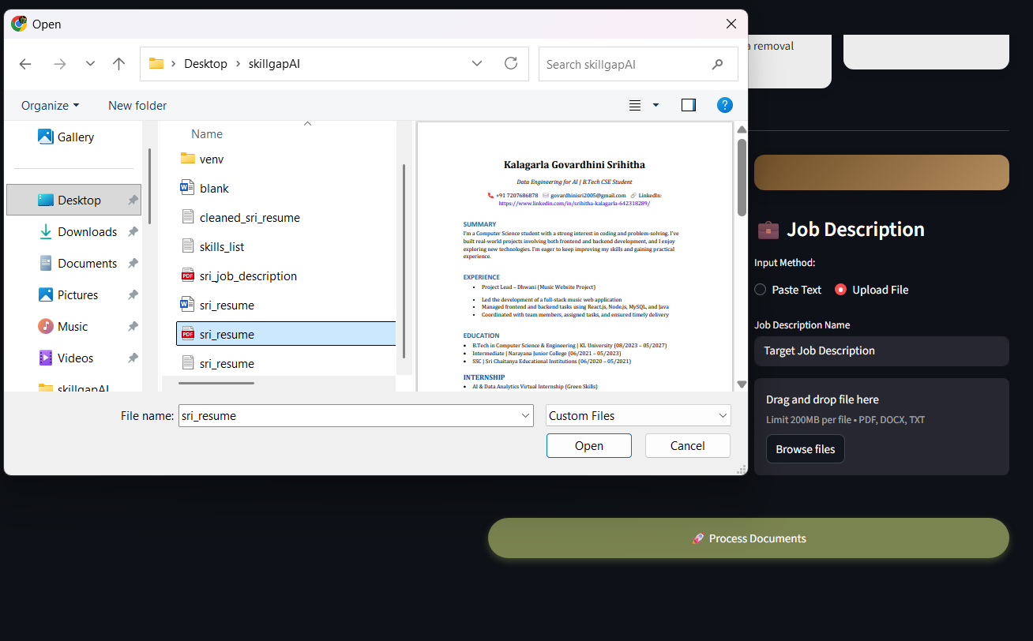
MILESTONE-1 OUTPUT

Slide 7

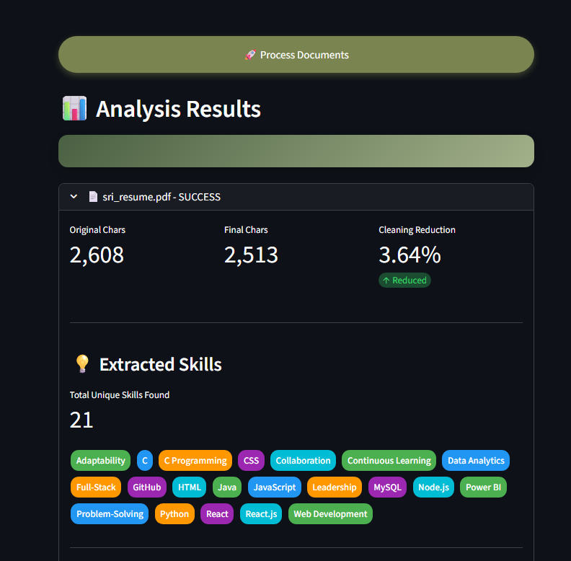
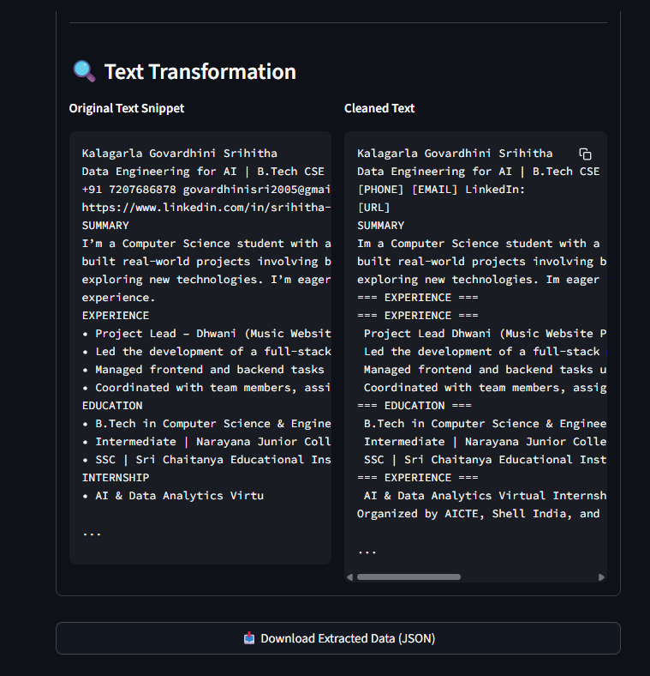

Slide 8


Advantages & Metrics
Automation: Provides fast, automated analysis of document collections.
Standardization: Converts highly variable inputs into structured, clean data.
Metrics: Summary of performance from the App: Total Documents Processed, Total Skills Found, and Average Text Optimization %.

Slide 9
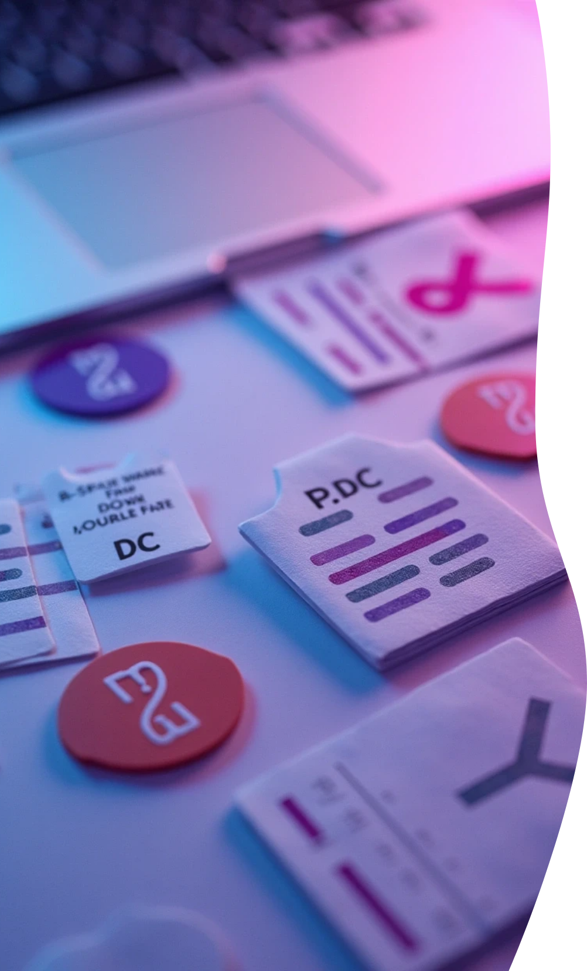
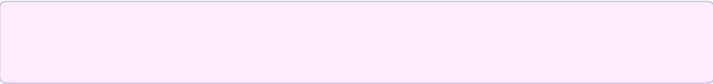
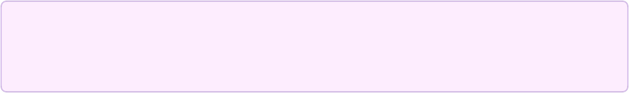
Challenges Overcome
File Diversity
Successfully ingested text from complex formats like PDF and DOCX.
Data Preparation
Established a robust cleaning layer that removes noise and personal data, creating high-quality input for NLP.

Slide 10

Thank You

